Slide 1
COVID - 19 & Mobility
Group 4

Slide 2
Question & Hypothesis
Explore the pandemic’s impact on mobility within the United States
Notes:
[Ingrid]
Intro: core questions + hypothesis
Why are we interested in this topic:
Highly relevant topic
Backed by robust data

Slide 3
Presentation Outline
The Data sources
The data’s limitation
The data cleaning and visualization processes
The questions arose along with our observations

Slide 4
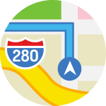
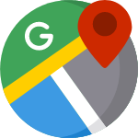
About the Data
Apple Map
Google Map
Intention
Input
Permission
Apple’s data only tracks destination searches
Google’s data only tracks destination input into the app
Google’s data only includes sample of users who enabled geo-location
Notes:
[Cynthia]
Question 1 - How does the Google data compare to the Apple data? Discuss two different types of data - Apple is people’s intentions (when people searched for locations) and Google is actual mobility data. Demographics of each? Limitations of each?
The data here shows relative change of mobility
Data Limitations:
Apple’s mobility data is based on locations searched, meaning the data might not reflect actual mobility, only intent. The assumption here is that locations search indicates a higher likelihood to travel to the searched location.
Users are unlikely to use map applications for familiar locations, so it is possible that data tracked only includes aberrant travels and not daily mobility.
Google’s data only includes the data users who have enabled geo-location settings; may not be representative of the wider population

Slide 5
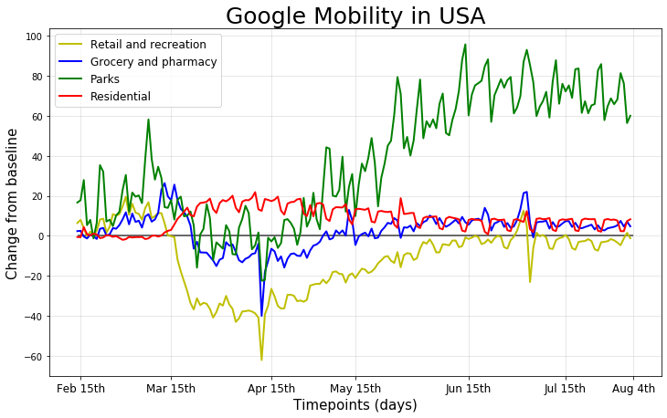
Overall Mobility
Notes:
[Stojancho] to talk about the Google data
Question 2 - How did mobility change over the course of the quarantine? Over Feb 15 - Aug 4 (dates?).
Observations:
Mobility decreased at the onset of the pandemic (mid-March to April), with sharp drops, across retail , groceries, and parks.
Visits to parks increased dramatically following April 15th.
Retail/recreation and groceries were the most heavily impacted, with a sharp decrease in April as quarantine set in, and businesses closed.

Slide 6

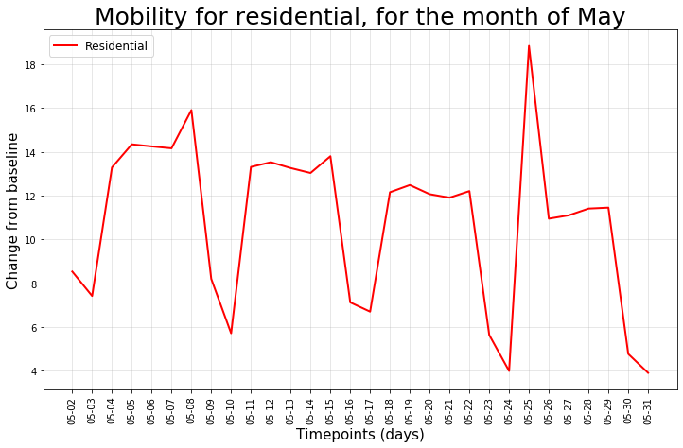
Residential
Notes:
Observations:
People stayed home at the onset of the pandemic, with a sharp rise in mid March.
However, overtime likelihood to remain in residentials decreased.
A repeating“zig-zagged” that happens (4x per month), which coincides with weekends, indicating that people are more likely to leave their residents during weekends.

Slide 7
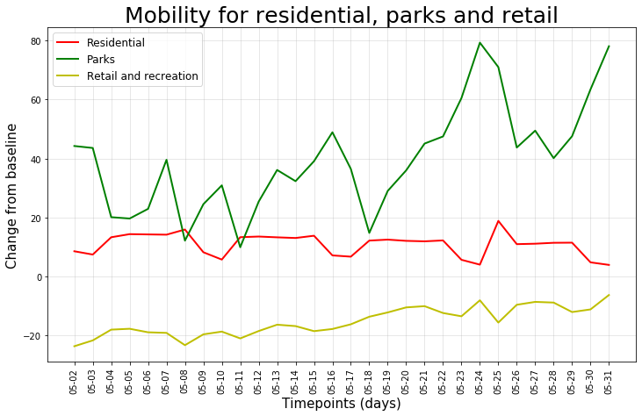



Holidays/Weekends
Notes:
Question 4 - How did mobility trends change relative to each other in the month of May?
This graph takes a closer look at the month of May*, Eventful month Mother’s Day weekend Memorial Day weekend
Observation:
Mother’s Day weekend (May 9 -10): Mobility exhibit minimal changes during the holidays, indicating that people were likely not celebrating holidays the typical way (e.g. shopping, dining out, etc)
Memorial Day weekend (May 23 - 25): Park visits saw a sharp spike, indicating people were opting to head outside for the long weekend. However, mobility to recreation/retail remain relatively static (still in the negative), indicating that people switch to online shopping, or reduced the shopping overall.

Slide 8


Findings Summary
Recreation + Retail
Residential
Weekends + Holidays
Park visits increased greatly while retail remained static
Quarantine behavior relaxed overtime
Travel to parks increased during weekends and holidays

Slide 9
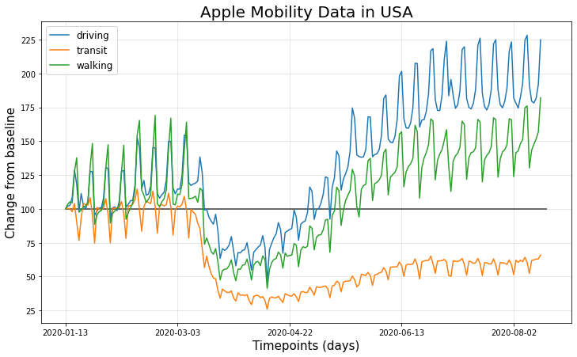



Transportation
Notes:
[Lisa]
Question 5 - Did mobility trends change related to different transportation types due to COVID?
As we decided to focus on the google USA dataset we also filtered the apple data to analyze only the USA - Remember that the data is based on requests for directions.
Point 1. - The weekly pulse of activity is immediately visible as people are, more or less, walking, driving, and taking the subway, depending on what day it is.
Point 2: looking at this graph You can see the big COVID-related drop-off in mobility clearly comes in mid-March.
Point 3 ; It is interesting to note the impact of COVID19 on mobility and that as the stay at home orders started to lift across the USA there is a notable increase in the number of requests for directions for driving and walking but there is a minimal increase in the requests for transit directions – nobody is yet willing to risk it on the subway!
Having looked at the overall mobility trends for the USA – we decided to look more into the mobility trends for a specific month. Firstly observing the trends for the overall month and then across 10 days within the month.
The Apple Mobility data used for this project is Time Series Data. Time series data is a collection of data points that are assembled over periods in time and ordered chronologically. The time interval at which the data is collected is often referred to as the time series frequency. The mobility measures taken are indexed to 100 at the beginning of the series, so mobility trends are relative to that baseline. We don’t know anything about the absolute volume of usage of the Maps service.
We needed to decompose the series into seasonal. In this case the “season” is a week and calculate the moving average.
https://www.datacamp.com/community/tutorials/moving-averages-in-pandas

Slide 10
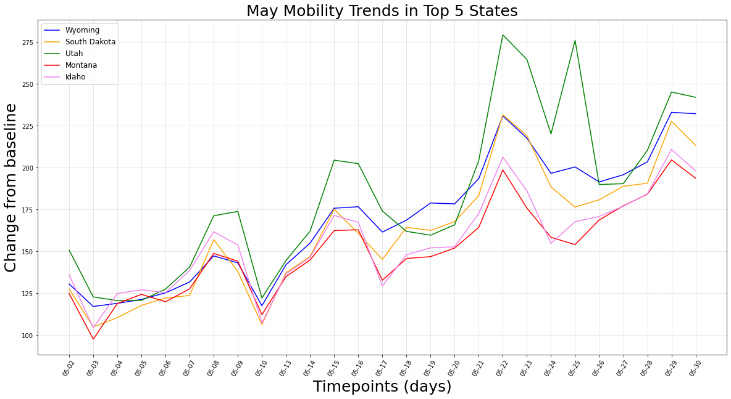
Transportation
Notes:
This graph illustrates a closer look at May trends*
Observation:
There is a slight increase in search activity between May 15 and 20, indicating that people may be researching/preparing to travel for the Memorial holidays
Similarly there was also a small spike in search activity during the Mother’s Day holiday. Which may indicate some intent/interest to travel or search for alternative ways of celebrating Mothers day
When we look at the month of May we can clearly see some spikes in activity, which like the google data could be linked to national holidays with the number of direction requests.

Slide 11
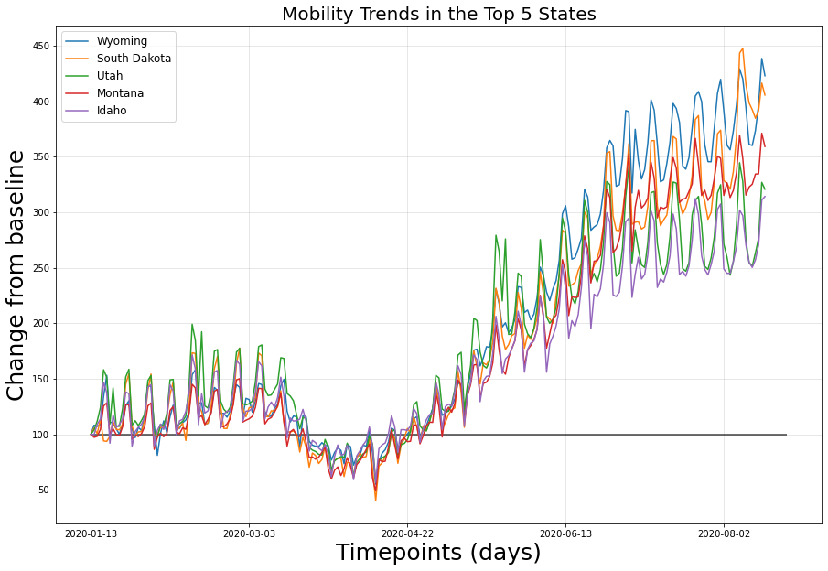
Five States with Highest Search Activity
Notes:
Observation:
In looking at search activity across top five states , we can see that people’s intent to travel follow similar patterns in general.
Top 5:
The top 5 states generally follow the same trends – there is an observable spike in mobility in Utah around May. Possibly due to a holiday or an event taking place there which something we would like to further research.

Slide 12
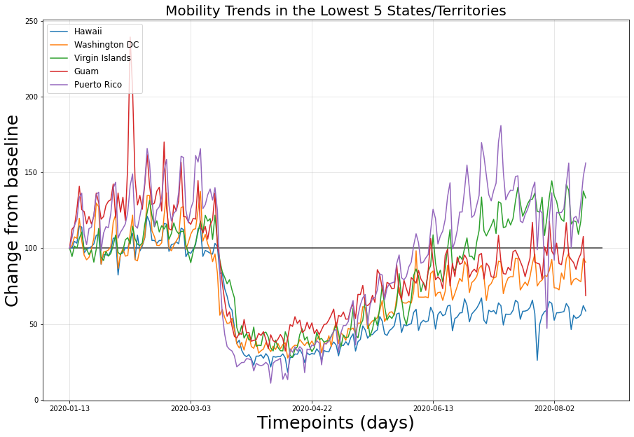
Five States/Territories with Lowest Search Activity
Notes:
Observation:
Finally, in looking at search activity across the five states with lowest mobility -- you can see that this also follows a general pattern overtime
Additionally, apart from Washington D.C., all other entities are islands with large tourism industries. The direction requests may have been affected by 1) people’s reluctance for travel, and 2) stricter guidelines for traveling in and out of islands (e.g. Hawaii) and around the island.
There is a very clear peak in mobility in Guam around February
This may be when the USS Theodore Roosevelt docked on Feb 7th which carried 5000 soldiers which then caused a spike in direction requests
Also to take into consideration for the increase in direction requests - There was an International Conference on Engineering and Applied Science was held at Guam starting on 18th February. It is a 3 day event
There is a spike in Guam between Jan and March (Feb 7)-- possibly because: https://www.postguam.com/news/local/photos-uss-theodore-roosevelt-docks-at-naval-base-guam/collection_34246d5e-496a-11ea-b6ee-930451b68644.html

Slide 13

Finding Summary
Driving
Transit
Overall
Travel via driving increased greatly
Travel via transit slowed dramatically and remained static
Interests in travel are slowly recovering

Slide 14


Overall Summary/Conclusion
Project Work
Next Steps
Notes:
[Lori]
Overall Conclusions
Working on this group project encouraged us to collaborate with each other and practice our Git skills. From brainstorming project ideas to completing the project, we learned from each other and increased our skill level in many aspects of data acquisition and data analysis.
Next steps and future projects could incorporate additional data sets to answer more questions. Other relevant data sets include Covid-19 infection rates, dates and duration of stay-at-home orders, pet adoption, local/state/national park attendance, pollution/emissions related to mobility, online retail/in-person retail, and many others.
Any questions?

Slide 15
Appendix
Additional Graphs generated

Slide 16
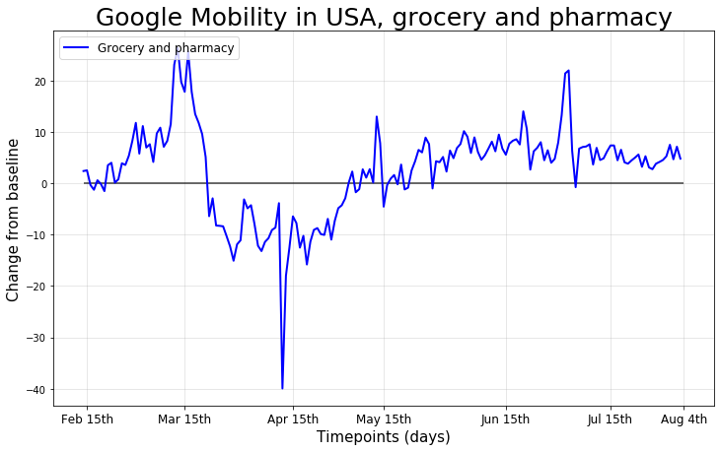
Grocery and Pharmacy
Notes:
Observations:
Retail and recreation went down, with a steep drop in mid March when qurantine became the norm.

Slide 17
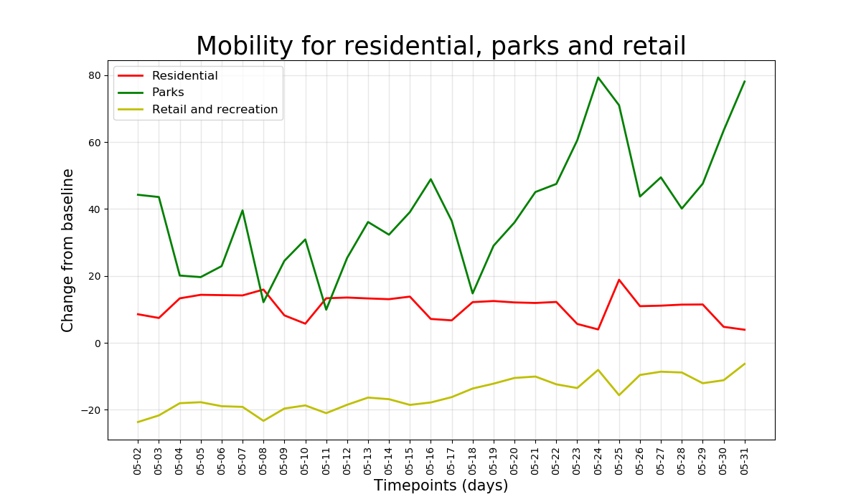
Behavior
Notes:
Conclusions - visits to parks increased greatly, residential increased, retail decreased. Conclusions based on holidays/weekends. Anecdote about Mother’s Day and retail shopping (no increase this year).

Slide 18
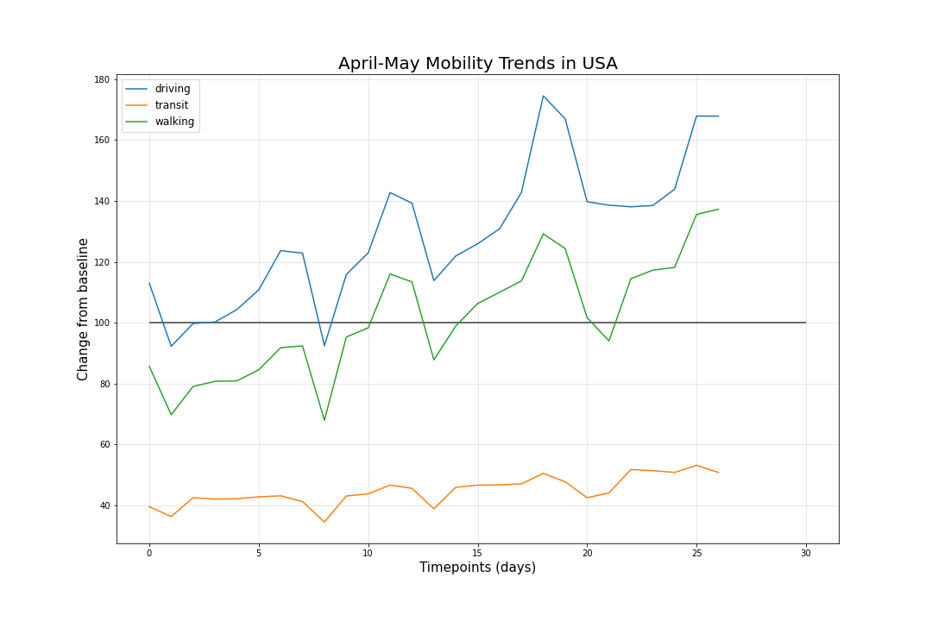
Transportation
Notes:
Question 5 - How did mobility change related to different transportation types? Lisa’s graph comparing driving/transit/walking. Larger changes in driving, not as much change in transit/walking. Stats related to the change? What are these numbers on y axis - the sum?

Slide 19
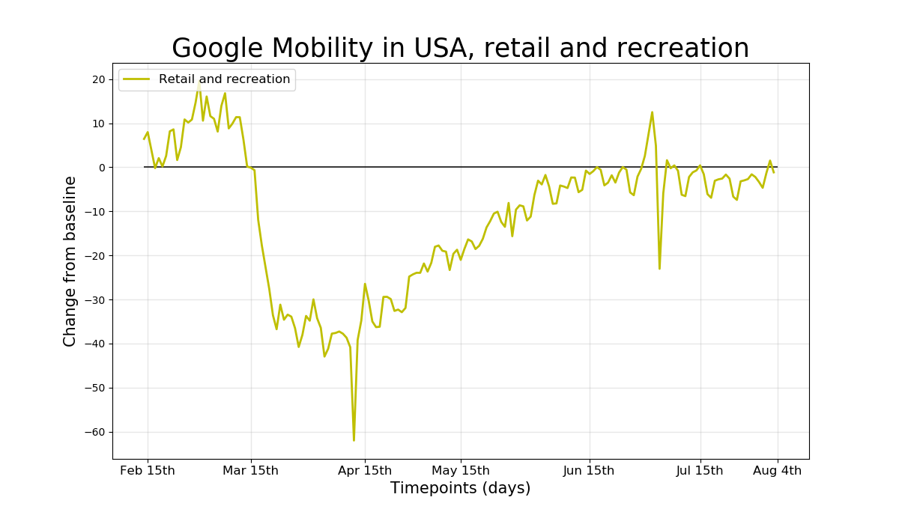
Retail and Recreations
Notes:
Retail and recreation went down, with a steep drop in mid March.

Slide 20
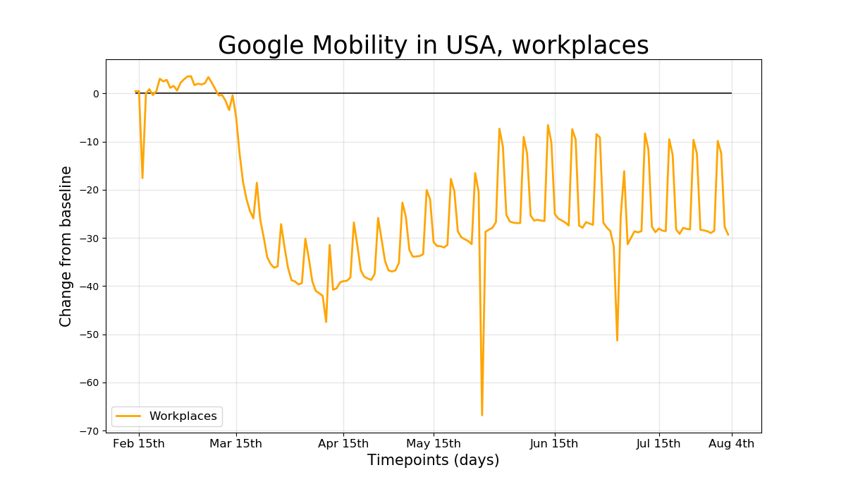

Behavior: Workplaces

